Slide 1

EL Instructional Academy
WS# 117542
Karina E. Chapa, M.Ed.
Language Proficiency, Biliteracy and Cultural Diversity Director
kchapa@esc1.net
Twitter @esc1bilingual @bilingualpride

Slide 2

Intellectual Property Statement
All materials, content, and forms contained in this training/presentation are the intellectual property of the Region One Education Service Center and are intended for use by session participant at the classroom, campus, or district level only. Materials are to be used “as is” without modification.
Materials may not be used for personal benefit or financial gain or for use outside of the school system.
www.esc1.net│facebook.com/RegionOneEducationServiceCenter│twitter.com/RegionOneESC

Slide 3

Professional Learning Essential Agreements
Be respectful of others
Be an active participant
Take care of your needs
Use electronic devices as learning tools
©2019 Region One Education Service Center

Slide 4
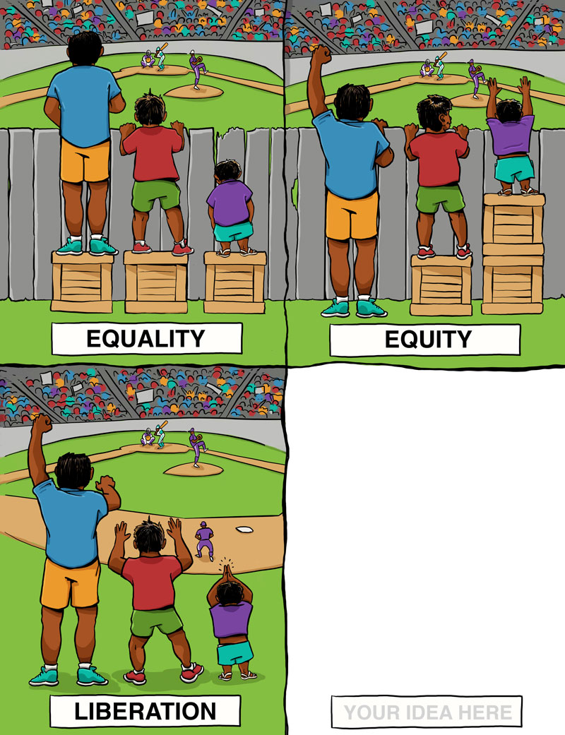
Think, Pair, Share!
YOUR IDEA HERE

Slide 5
Sheltered instruction
Strategies

Slide 6
Session Objectives
Content Objective
Language Objective
Today I will explore sheltered instruction techniques and strategies to make content comprehensible for ELs.
Today I will share different ideas on how to implement sheltered instruction strategies in the classroom.

Slide 7
Three-Step Interview
Stand up when you can complete one of these sentences:
  Teaching ELLs is so difficult because…
  One challenge I face when teaching ELLs is…
  One challenge I face when instructing ELLs is… What I have done to overcome this challenge is…
Beginner
Intermediate
Advanced

Slide 8
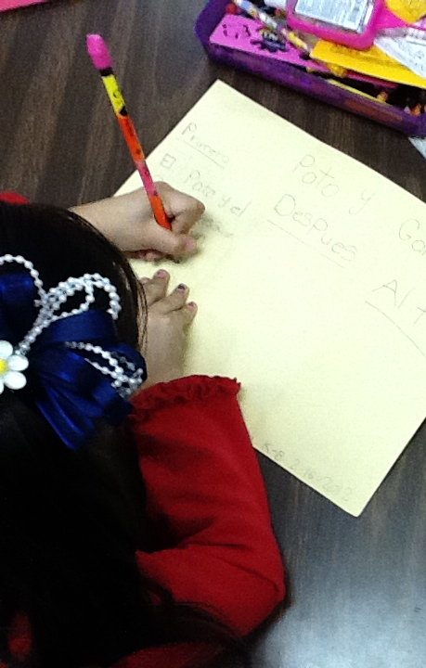
What are the two goals of Sheltered Instruction?
Make Content Comprehensible
Develop Academic Language

Slide 9
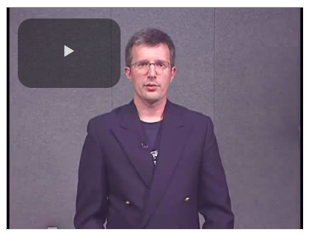
Latvian Video
https://projects.esc20.net/page/lpac_resources-hidden

Slide 10

SHELTERED INSTRUCTION
Content and Language Objectives

Slide 11

Make an Appointment

Slide 12
Content and language objectives

Slide 13

Anticipation Guide
kahoot.it
create.kahoot.it
Let’s Kahoot!

Slide 14
Round Table
Draw a T chart
Write everything you know about content and language objectives
15 seconds!
Pass your paper to your right!
Repeat!
Content Objectives
Language Objectives
Let’s Write!

Slide 15
The What and the How
Content Objectives come from the TEKS
What am I going to learn?
Language Objectives come from the ELPS
How will I demonstrate my learning through listening, speaking, reading and/or writing?
Content and Language Objectives

Slide 16
Content Objective - Sample
Science TEKS: Differentiate between structure and function in plant and animal cell organelles including cell membrane, cell wall, nucleus, cytoplasm, mitochondria, chloroplast and vacuole.
Student Friendly format: Today I will compare and contrast the cell structures and functions of plants and animals.

Slide 17
Writing Content Objectives
Pair-up
Analyze a Student Expectation (TEKS) from any content area
Write it in a student-friendly format on the top of your chart paper
You have 2 minutes
Today I will…

Slide 18
Science TEKS: Differentiate between structure and function in plant and animal cell organelles including cell membrane, cell wall, nucleus, cytoplasm, mitochondria, chloroplast and vacuole.
CONTENT OBJECTIVE
Today I will compare and contrast the cell structures and functions of plants and animals.
LANGUAGE OBJECTIVE
©2019 Region One Education Service Center

Slide 19
Language Objective - Sample
Content Objective:
Today I will compare and contrast the cell structures and functions of plants and animals.
Language Objective:
Today I will write an essay comparing and contrasting plant and animal cells utilizing transitional phrases.

Slide 20
Writing Language Objectives
Pair-up
Look back at the content objective you wrote
Write a language objective in a student-friendly format below your content objective
You have 2 minutes
Today I will…

Slide 21
Science TEKS: Differentiate between structure and function in plant and animal cell organelles including cell membrane, cell wall, nucleus, cytoplasm, mitochondria, chloroplast and vacuole.
CONTENT OBJECTIVE
Today I will compare and contrast the cell structures and functions of plants and animals.
LANGUAGE OBJECTIVE
Today I will write an essay comparing and contrasting plant and animal cells utilizing transitional phrases.
©2019 Region One Education Service Center

Slide 22
Key Points to Remember
Make objectives student friendly and appropriate for grade level.
Objectives are for students, not for the adults in the classroom.
Post eye level.
Review with students before, during and after each lesson.

Slide 23
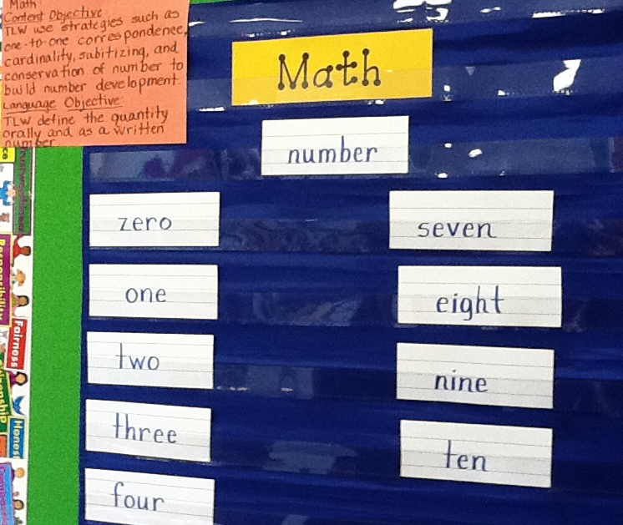
Provide Feedback
Content and Language Objectives

Slide 24
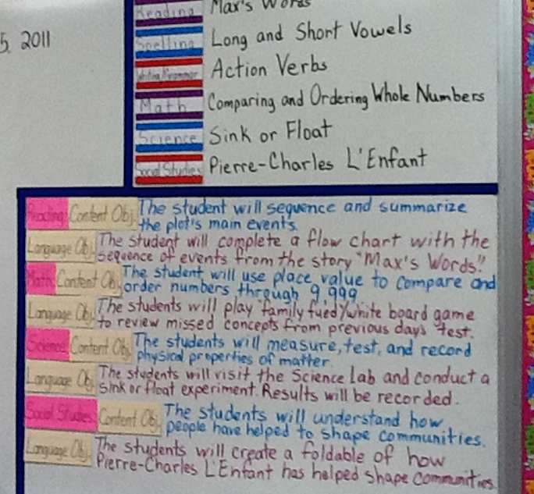
Provide Feedback
Content and Language Objectives

Slide 25
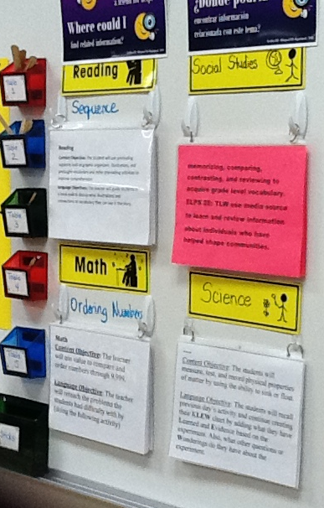
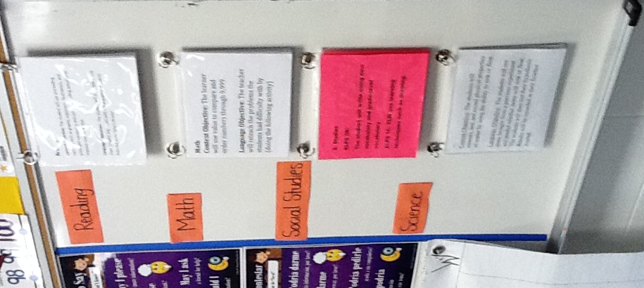
Provide Feedback

Slide 26
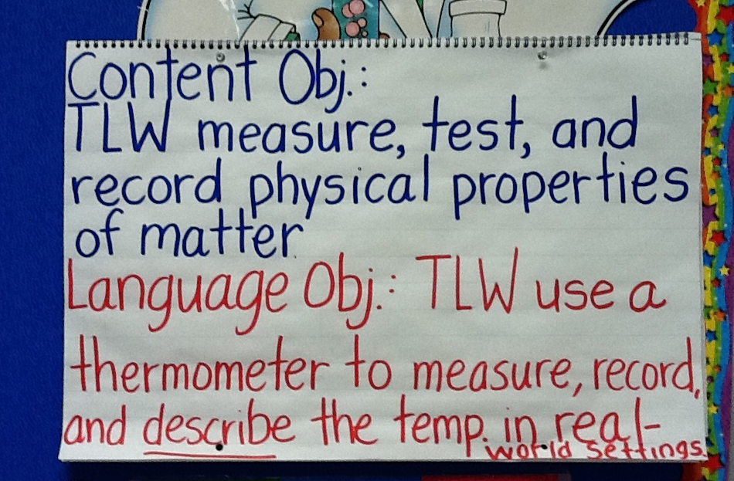
Provide Feedback

Slide 27
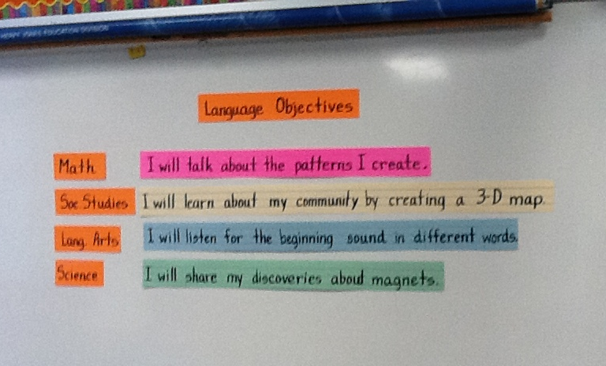
Provide Feedback

Slide 28
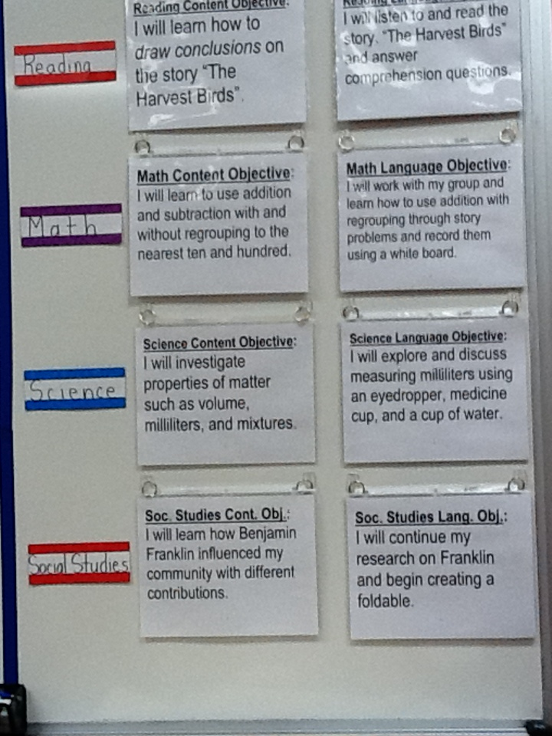
Provide Feedback
Content and Language Objectives

Slide 29
SHELTERED INSTRUCTION
Content and Language Objectives

Slide 30
RANDOMIZATION TECHNIQUES

Slide 31
Randomization Techniques
Write-Read-Read-Trade
Stand up when you complete in writing one of these sentences:
  I select who I call on by…
  In my classroom, I include randomization because…
  The most beneficial randomization technique I have used is… because…
  Go to your 9 o’clock!
  Go to your 12 o’clock!

Slide 32
Randomization Techniques
Is it possible to randomize and differentiate instruction at the same time?
Randomize and rotate who is called on,
so students of all language levels can participate!

Slide 33
Randomization Techniques
Lucky sticks
Beach ball
Index cards
with student names
Class list/roster
Color/numbers
Birthdays
Physical characteristics: longest hair, eye color…
Jenga
Pick up sticks
Career cards
Apps
Popcorn

Slide 34
SHELTERED INSTRUCTION
Content and Language Objectives
Randomization Techniques

Slide 35
Total response signals

Slide 36
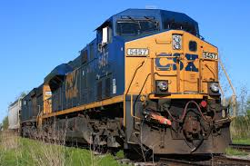
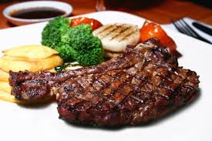
Why is it important to check for understanding along the way?

Slide 37
Written Responses
Hold up paper
White boards
Ready Responses
Hands up when ready
Personal Chalkboards
Answers on cards
Thinker’s chin
Stand up when ready
Put your pen on your paper when ready
All eyes on teacher
Making Choices
Open hand/closed hand
Ranking
Rank with your fingers
Thumbs/Pens up/down
Number wheels
Green card/red card
Move to the corner/spot
Rank with your arm
Line up according to response
Knocking/clapping/
cheering

Slide 38
Find the Fib!
Students may work in pairs or small groups.
Students have three post-its/index cards with the numbers “1, 2, 3” in each card.
Teacher writes 3 statements on the board (one false, two true) and students decide which one is the fib.
On signal from teacher, students show the number of the statement they believe is the fib.

Slide 39
Let’s Play!
Find the Fib
Evaporation is part of the water cycle
Refraction is part of the water cycle
Condensation is part of the water cycle
      I believe number… is a fib because…

Slide 40
Find the Fib
Cognitive and academic development in native language has an important and positive effect on second language acquisition.
Once students can speak English, they are ready to undertake the academic tasks of the mainstream classroom.
According to research, students in ESL-only programs, with no schooling in their native language, take 7-10 years to reach grade level norms.
Let’s Play!

Slide 41
Let’s Play!
Find the Correct Answer
Rhea is a moon of Saturn. Which of these facts about Rhea best indicates that it does not have a water cycle in which water changes state?
A Its radius is 765 km.
B Its density is about 1.3 kg/m3.
C Its period of rotation is about 4.5 Earth days.
D Its temperature is between −174°C and −220°C.

Slide 42
SHELTERED INSTRUCTION
Content and Language Objectives
Randomization Techniques
Total Response Signals

Slide 43
Developing academic vocabulary

Slide 44
1. When you can complete this sentence in your mind, please stand up.
Academic vocabulary development is important for ALL students, but especially for ELs, because…
2. Find your 3 o’clock appointment and share your responses.

Slide 45
What does this mean?
Carving is appropriate for most green and blue slopes and even some black slopes. However, if you try to carve through moguls, especially in packed powder or corn snow, you’re going to face-plant.

Slide 46
What does this mean?
Carving is appropriate for most green and blue slopes and even some black slopes. However, if you try to carve through moguls, especially in packed powder or corn snow, you’re going to face-plant.

Slide 47
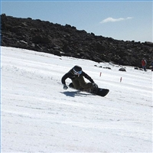

Would this help?
These men are carving.

Slide 48
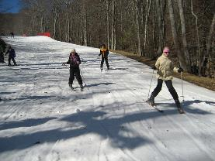
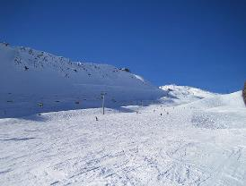
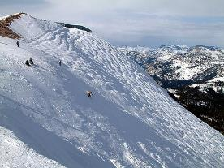
How about this?
Green Slope
Blue Slope
Black Slope

Slide 49
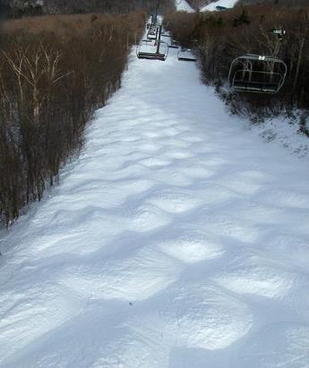
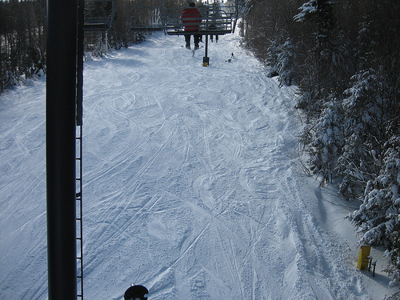
Moguls Packed Powder

Slide 50
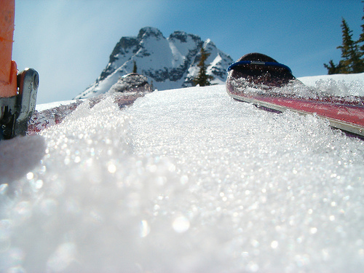
Corn Snow

Slide 51
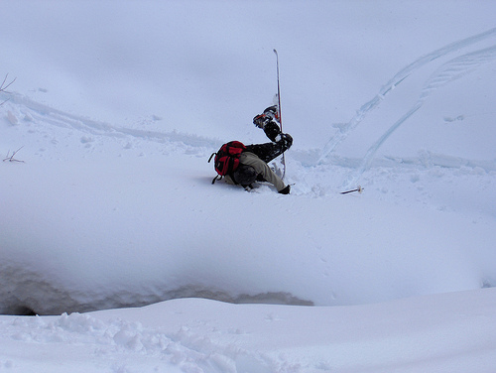
Face-plant

Slide 52









Carving is appropriate for most green and blue slopes
and even some black slopes. However, if you try to carve
through moguls, especially in packed powder or corn snow
you’re going to face-plant.
apropiado
especialmente

Slide 53
Vocabulary Experts
Number Heads 1-8
Form Expert Groups
Each team creates a visual explaining the activity
Back to original groups
Expert Groups

Slide 54




1. Free Association
http://bit.do/freeassociation
2. Comparing Terms
http://bit.do/comparingterms
3. Classifying Terms
4. Solving Analogy Problems
5. Creating Metaphors
6. Vocabulary Charades
7. Talk a Mile a Minute
http://bit.do/morevocabulary
8. Pyramid Game
http://bit.do/ pyramidgame
Notes:
3.5 hours

Slide 55
SHELTERED INSTRUCTION
Content and Language Objective
Randomization Techniques
Total Response Signals
Academic Vocabulary

Slide 56
Structured reading and writing activities

Slide 57
SQP2RS
Survey
Question
Predict
Read
Response
Summarize

Slide 58
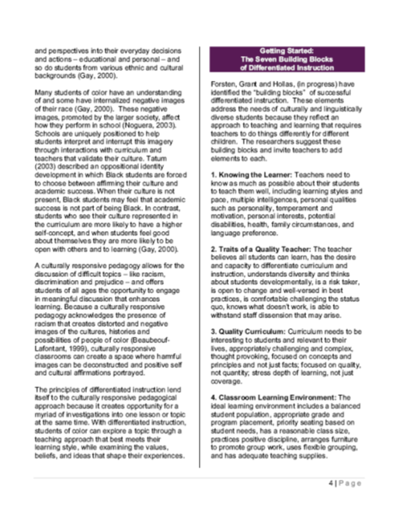
SQP2RS
Survey
Question
Predict
Read
Response
Summarize

Slide 59



Inside-Outside Circle
A
Read
Cover
Remember
Retell
Sketch!
B
AB

Slide 60
Go to your 6 o’clock
One of the benefits of including structured reading and writing activities in my classroom is…
One of the challenges of including structured reading and writing activities in my class is…
Something I can do to overcome this challenge is…

Slide 61
Structured Reading and Writing Activities
Adapted Texts
SQP2RS
Graphic Organizers
Thinking Maps
Jigsaw Reading
Outlines
Highlighted Texts
1-2-4-All
Round Table
Taped Texts
Marginal Notes
Native Language Texts
Write-Read-Read-Trade
Read-Cover-Remember-Retell-Sketch!

Slide 62
SHELTERED INSTRUCTION
Content and Language Objective
Randomization Techniques
Total Response Signals
Academic Vocabulary
Structured Reading and Writing

Slide 63
Structured conversations

Slide 64
1-2-4-ALL
Why is it important to encourage English Learners to speak in complete sentences?
Write your individual answer on a piece of paper.
Share with a partner and add any new ideas to your paper.
Now share your answers with another pair and keep adding new ideas to your own papers.
As a whole table come up with a final complete answer.

Slide 65
Use of Complete Sentences
Does this mean that students need to answer in complete sentences all the time?
TIP:
Provide students with sentence frames and sentence starters if they are struggling to produce complete thoughts in English.

Slide 66
Use of Complete Sentences
  1. When reviewing a handout or worksheet
    Non-Example
    Teacher: How much is 5 X 4?
    Student: 20!
    Example
    Teacher: What is the product of 5 X 4?
    Student: The product of 5 and 4 is 20

Slide 67
Use of Complete Sentences
  2. When students are given sentence starters
    Non-Example
    Teacher: Who is your favorite character and why?
    Student: Esperanza!
    Example
    Teacher: Who is your favorite character and why? Please complete the following sentence: “My favorite character is… because…”
    Student: My favorite character is Esperanza, because she was very brave.

Slide 68
Your Turn! Gallery Walk!
Using the Content and Language Objectives that you developed, write 1 question and 1 sentence stem that your students might be able to answer throughout the lesson.
Write them on post-its and place them on your chart paper.

Slide 69

Structured Conversations
Think-Pair-Share
Think-Write-Pair-Share
Question-Signal-Stem-Share-Assess
Expert Gallery Walk
Three-Step Interview
1-2-4-All

Slide 70
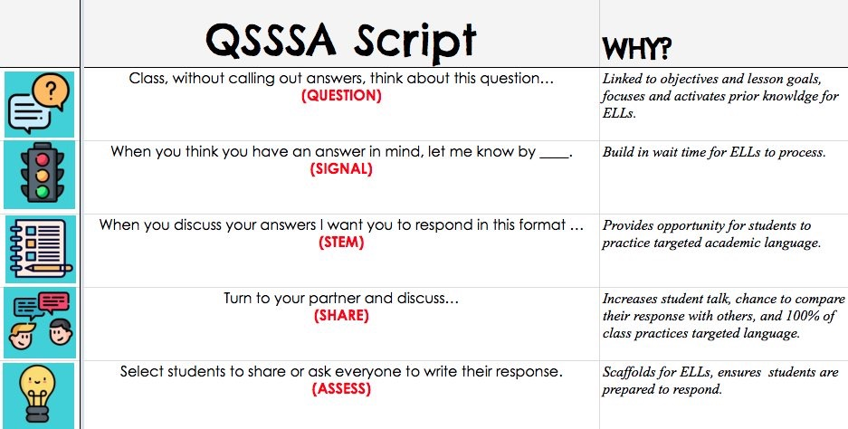
Why do ELs need to have structured conversations?
Standing up!
English Learners need structured conversations because…
(talk, talk, talk!)
Student #18, please share your response with the whole group
@MrsGill_ @MsSalvac @Seidlitz_Ed @JohnSeidlitz

Slide 71
SHELTERED INSTRUCTION
Content and Language Objective
Randomization Techniques
Total Response Signals
Academic Vocabulary
Structured Reading and Writing
Structured Conversations

Slide 72

Use of Social Media
Twitter for Professional Development
  @esc1bilingual
  @bilingualpride
  @rgv_tabe
  @edutopia
  @ColorinColorado
  @educationweek
  @teainfo

Slide 73
Session Objectives
Content Objective
Language Objective
Today I explored sheltered instruction techniques and strategies to make content comprehensible for my ELs.
Today I shared different ideas on how to implement sheltered instruction strategies in my classrooms.

Slide 74

Exit Tickets: Backchannel Chat kb42y
3 Things I learned today…
2 Things that I will share with my colleagues…
1 Thing that I will implement next year…
http://bit.do/Day3LFISD

Slide 75
¡Mil gracias!
Have a fantastic summer!
Karina E. Chapa, M.Ed.
Language Proficiency, Biliteracy and Cultural Diversity Director
kchapa@esc1.net
Facebook: Region One ESC Bilingual
Twitter @esc1bilingual @bilingualpride

